Slide 1
INTE 22283 – Mobile Application Development
Week 2: Mobile Operating Systems
Sammani Maddumahewage
Lecturer (Probationary)
BSc (Hons) in Information Technology

Slide 2
Today's Learning Outcomes
Describe the architecture of the Android operating system (kernel, runtime, framework, application layers)
Describe the architecture of iOS and compare it with Android
Identify other mobile operating systems and their market relevance
Explain the Android application lifecycle and process model
Discuss permission models and sandboxing in mobile operating systems
Compare update cycles, fragmentation, and device compatibility issues
Set up the Android Studio development environment and emulator
Explore the structure of a basic Android project

Slide 3
Recap: Where We Are in the Module
Last week: We covered mobile computing fundamentals and how mobile networks connect devices
This week: We move from the network layer up to the operating system — the software platform that every mobile app runs on top of
Why this matters: Every design decision in later weeks (UI, architecture, APIs, security) depends on which OS the app targets and how that OS manages apps, permissions, and resources

Slide 4
What Is a Mobile Operating System?
Definition: System software that manages hardware resources, provides a runtime environment for apps, and exposes APIs that developers use to build applications
Core responsibilities: Process management, memory management, security enforcement, hardware abstraction, and user interface services
Why mobile OS design differs from desktop: Mobile OSes must operate under strict battery, memory, and storage constraints while keeping the device responsive and secure

Slide 5
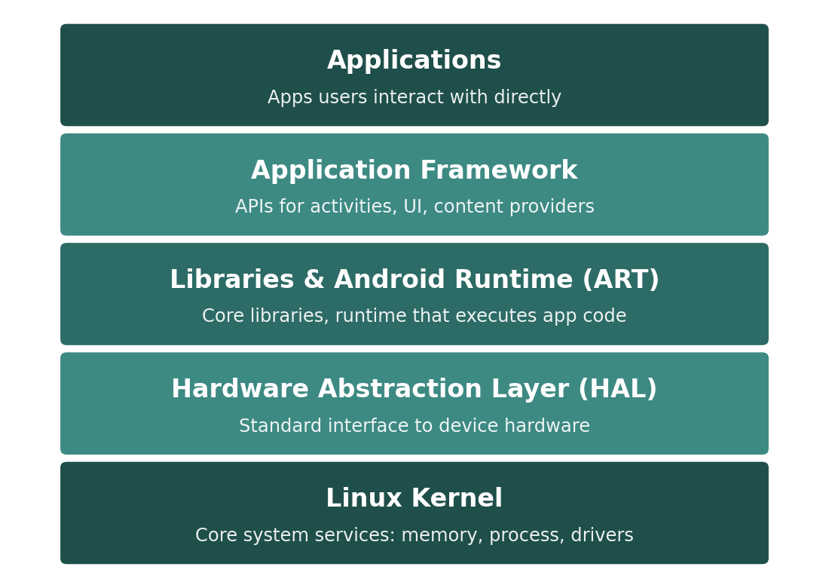
Android Architecture: The Software Stack
[ INSERT IMAGE ]
Applications: The apps users actually open and interact with
Application Framework: Reusable APIs (Activity Manager, Content Providers, Views) that apps are built on
Libraries & ART: Native libraries plus the Android Runtime that compiles and executes app code
HAL & Linux Kernel: The hardware abstraction layer and kernel that manage drivers, memory, and processes
Figure 1: Android is organized into five layers, each building on the one below it

Slide 6
Android Architecture Layers
Linux Kernel
Provides core system services: process management, memory management, device drivers, and security
Hardware Abstraction Layer (HAL)
Standard interfaces that let higher layers use hardware (camera, sensors, audio) without knowing device-specific details
Android Runtime (ART) and Native Libraries
ART compiles app bytecode to native instructions; libraries provide functionality like SQLite, WebKit, and SSL
Application Framework
Java/Kotlin APIs that apps use directly: Activity Manager, Window Manager, Content Providers, Notification Manager
Applications
Both system apps (Phone, Settings) and third-party apps installed by the user, all running on the same framework

Slide 7
iOS Architecture Overview
Core OS layer: The lowest level — kernel (XNU, based on Darwin/BSD), drivers, and core hardware services
Core Services layer: Fundamental system services such as networking, location, and data management
Media layer: Graphics, audio, and video technologies (Core Graphics, Core Animation, AVFoundation)
Cocoa Touch layer: The topmost layer providing the UI frameworks (UIKit, SwiftUI) that apps are built with directly

Slide 8
Android vs. iOS: Architectural Comparison
Table 1: Key architectural and ecosystem differences between the two dominant mobile platforms
Aspect | Android | iOS
Kernel | Linux kernel | XNU (Darwin/BSD-based)
Primary languages | Kotlin, Java | Swift, Objective-C
App distribution | Google Play + sideloading | App Store only (largely)
Hardware vendors | Many (Samsung, Xiaomi, etc.) | Apple only
Customization | High (open ecosystem) | Lower (tightly controlled)

Slide 9
Why the Architectural Differences Matter
Openness vs. control: Android's open-source, multi-vendor model enables device diversity but creates the fragmentation challenges discussed shortly
Single-vendor consistency: Apple's tight hardware-software integration in iOS gives more predictable performance and update behavior, at the cost of platform flexibility
Developer implication: Targeting both platforms generally requires either two native codebases or a cross-platform framework — the subject of Week 3 and Week 12

Slide 10
Other Mobile Operating Systems and Market Relevance
HarmonyOS (Huawei): Developed after Huawei lost access to Google services; growing market share primarily in China
KaiOS: A lightweight OS for feature phones, significant in emerging markets where smartphones remain costly
Historical context: Platforms like Windows Phone and BlackBerry OS once held meaningful market share but have been discontinued
Practical takeaway: Android and iOS together account for the overwhelming majority of the global market — this module focuses primarily on Android for hands-on development

Slide 11
Why Lifecycle Management Exists
The problem: Mobile devices have limited memory, and users frequently switch between apps, receive calls, or lock their screens
The OS's job: Android must decide which apps stay in memory, which get paused, and which get terminated — without losing user data or confusing the user
The developer's job: Apps must correctly respond to lifecycle events so they save state, release resources, and resume correctly

Slide 12
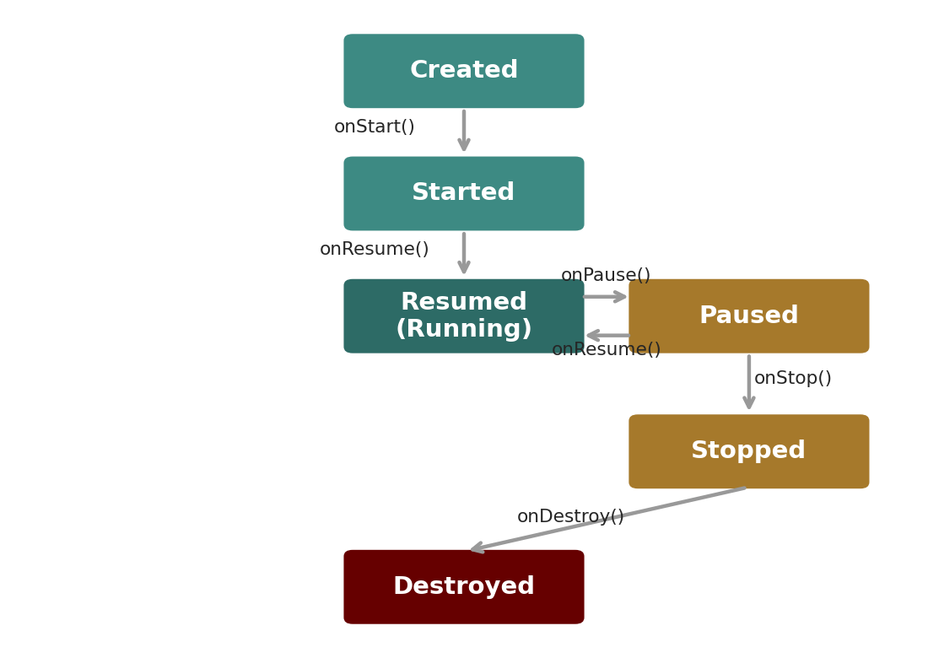
The Activity Lifecycle
[ INSERT IMAGE ]
Created → Started → Resumed: The activity becomes visible and interactive
Paused: Activity is partially visible but not in focus (e.g., a dialog appears)
Stopped: Activity is no longer visible (e.g., user switched apps)
Destroyed: Activity's resources are released, either by the user or the system
Figure 2: Every Activity moves through a well-defined sequence of states, each with a corresponding callback method

Slide 13
Key Lifecycle Callback Methods
onCreate()
Called once when the Activity is first created; used to initialize UI and data
onStart() / onResume()
Activity becomes visible (onStart) and then interactive (onResume)
onPause()
Called when the activity loses focus; used to save lightweight state and pause ongoing actions (e.g., video playback)
onStop()
Called when the activity is no longer visible; used to release resources not needed while hidden
onDestroy()
Final cleanup before the activity is removed from memory

Slide 14
The Android Process Model
Each app runs in its own process: By default, every Android app runs in its own Linux process with a unique user ID, isolating it from other apps
Process priority levels: Android ranks processes (foreground, visible, service, background, empty) and kills lower-priority processes first when memory is needed
Why this matters for developers: An app moved to the background can be killed at any time — robust apps must persist important state so users don't lose progress
Multi-process apps: Some apps deliberately run components in separate processes (e.g., isolating a crash-prone library) for stability

Slide 15
The Sandbox Model
Definition: Each app runs in an isolated environment with restricted access to system resources and other apps' data
Android's implementation: Each app is assigned a unique Linux user ID (UID); the kernel enforces that one app's files and memory cannot be accessed by another app directly
iOS's implementation: Apps run in a similar sandbox enforced by the kernel, with strict entitlements controlling what system resources an app can use
Why sandboxing matters: It limits the damage a malicious or buggy app can do — this is a foundational security mechanism we revisit in depth in Week 13

Slide 16
Permission Models: Install-Time vs. Runtime
Install-Time Permissions
Runtime Permissions
Used for: Low-risk permissions (e.g., internet access)
Behavior: Granted automatically when the app is installed
User control: Limited — user can only choose not to install the app
Used for: Sensitive permissions (camera, location, contacts)
Behavior: App must request permission while running; user approves or denies
User control: High — permissions can be revoked at any time in system settings

Slide 17
Why Modern Permission Models Evolved This Way
Early Android (pre-6.0): Used install-time-only permissions — users had to accept everything or not install the app at all
Modern Android (6.0+) and iOS: Use runtime permission requests for sensitive capabilities, giving users granular, revocable control
Principle of least privilege: Well-designed apps should request only the permissions they actually need, when they need them — this is both a security best practice and an app-store review requirement

Slide 18
Android Fragmentation
Definition: The wide variety of Android OS versions, screen sizes, and hardware capabilities in active use simultaneously
Root cause: Android updates depend on device manufacturers and carriers to distribute them, leading to long delays or many devices never receiving updates
Practical consequence for developers: Apps must be tested across multiple OS versions and screen configurations, and gracefully handle missing newer-API features on older devices
iOS comparison: Apple controls hardware and software together, so iOS updates reach the vast majority of supported devices quickly, greatly reducing fragmentation

Slide 19
Managing Compatibility in Android Development
Table 2: Common tools developers use to handle fragmentation
Tool / Concept | Purpose
minSdkVersion | Sets the oldest Android version the app supports
targetSdkVersion | Declares the version the app is optimized and tested for
AndroidX libraries | Backward-compatible APIs that work across many OS versions
Responsive layouts | Layouts that adapt to different screen sizes and densities

Slide 20
Worked Example: An App Losing Data on Rotation
Scenario: A user fills out a form, rotates their phone, and the form data disappears
What actually happened: Screen rotation destroys and recreates the Activity by default — triggering onDestroy() and a fresh onCreate()
Root cause: The developer didn't save the form data during the lifecycle transition
Correct fix: Save transient UI state in onSaveInstanceState() and restore it in onCreate(), or use a lifecycle-aware ViewModel that survives configuration changes

Slide 21
Worked Example: A Permission Denied at Runtime
Scenario: A camera app requests camera access; the user denies it
What the OS does: Android does not crash the app — it simply does not grant access, and the app must handle this case explicitly
Poor design: An app that crashes or freezes when permission is denied
Good design: The app explains why the permission is needed and offers an alternative path (e.g., manually entering data) if permission is refused

Slide 22
Setting Up the Android Studio Environment
Android Studio: The official IDE for Android development, built on JetBrains' IntelliJ platform
Android SDK: Software Development Kit containing the libraries and tools needed to build, debug, and run Android apps
Android Virtual Device (AVD) / Emulator: A simulated Android device used to test apps without physical hardware
Gradle: The build system Android Studio uses to compile code, manage dependencies, and package the app

Slide 23
Structure of a Basic Android Project
manifests/AndroidManifest.xml
Declares the app's components, permissions, and metadata the OS needs to run it
java/ (or kotlin/)
Contains the source code: Activities, Fragments, and supporting classes
res/ (resources)
Layout XML files, images, strings, and other non-code assets, organized by type
build.gradle (module and project level)
Configures dependencies, SDK versions, and build settings
Gradle Scripts
Supporting build configuration files generated and managed by Android Studio

Slide 24
Key Takeaways
Android's architecture is a layered stack: Linux kernel, HAL, libraries/ART, application framework, and applications
iOS uses a comparable layered model but with tighter hardware-software integration and a more controlled distribution model
The Activity lifecycle (Created, Started, Resumed, Paused, Stopped, Destroyed) governs how apps respond to system and user events
Sandboxing isolates each app for security; permission models (install-time vs. runtime) control access to sensitive resources
Fragmentation is a major practical challenge in Android development, managed through SDK version targeting and compatibility libraries

Slide 25
Summary
This week moved from the network layer to the operating system layer, examining how Android and iOS are architected, how apps move through a managed lifecycle, and how sandboxing and permissions protect users.
We also looked at why fragmentation is a uniquely significant challenge for Android developers, and set up the practical foundation — Android Studio and project structure — needed for hands-on development.
Next week, we build on this foundation by comparing native, hybrid, and cross-platform approaches to actually building mobile applications.

Slide 26
Discussion Questions
Why might Apple's tightly controlled ecosystem lead to less fragmentation than Android's open ecosystem? Is this purely an advantage, or are there trade-offs?
Consider an app that plays music. Which lifecycle callback(s) should it use to pause music when the user switches apps, and why?
A weather app requests location permission the moment it opens, before explaining why. How might this affect user trust, and how would you redesign the request flow?
If you were choosing between developing for Android first or iOS first for a new startup, what factors from today's lecture would influence your decision?

Slide 27
Thank You !
Questions?
Email: Sammani@kln.ac.lk | Department of Industrial Management

